Slide 1

Kick-off Meeting
Rabat, Morocco
9 - 10 June 2013
Regional Knowledge Network on Systemic Approaches to Water Resources Management
2013 – 2015

Slide 2


Who Are We?
Why Are We Here?
Characteristics of Teams?
COACH

Slide 3
Workshop AGENDA
Time | Day 1 | Who?
9:00-9:30 | Openning Remarks Opening & Getting to know Each Other (Expectations from the Workshop) = Workshop Objectives, Organization & Agenda-Moderator | EU & IUCN (5 Minutes Maximum/Speech) Mu'taz Al-Taher (Moderator)
9:30-10:15 | Refresher on the Key Elements of the Proposed Project (RKNW)- Fadi Shraideh | Fadi Shraideh / IUCN
10:45-11:00 | Presentation on Generic Concepts, Tools, Procedures and Structures Relevant to Building and Sustaining Knowledge Management Networks-Moderator | Mu'taz Al-Taher (Moderator)
11:00-11:30 | Morning Break
11:30-13:00 | Creating/Agreement on the Vision | Moderated Plenary Session
 | Understand collective and individual institutional environments as a basis for integration and cooperation (Challenges & Opportunities)
13:00-13:30 | Agreement on the Clustering of Institutional Environmental Elements | Moderator-Led
13:30-14:30 | Lunch Break
14:30-15:15 | Presenting a Proposed Conceptual Operational Framework for the Project | Fadi Shraideh / IUCN & Moderator
15:15-15;45 | Brainstorming on the requirements to build and sustain the proposed frameworks (& forming workgroups for afternoon sessions): Group 1: Management & Operation Group 2: Communication and Networking Group 3 Distribution of Tasks and Roles | 15 minutes for presentation & 15 minutes for discussions for each WG
15:45-16:15 | Afternoon Break
16:15-17:00 | Workgroups: getting organized and started: Each WG will discuss and present actions needed to fulfill each requirement | Groups' Moderators
17:00-17:15 | Evaluation of the Day: What should we do differently tomorrow? | Participants

Slide 4
Workshop AGENDA
Time | Day 2 | Who & How?
9:00-9:15 | Recap of Day 1 and Presenting Day 2 Tasks & Programme | Moderator
9:15-11:10 | Workgroups: discussion and getting ready to present actions needed to fulfill each requirement | Groups' Moderators
11:00-11:30 | Morning Break Taken in the Group Work
11:30-13:00 | Presentations of WGs Outputs: 15 minutes for presentation & 15 minutes for discussions for each WG | WGs Reporters
13:00-13:30 | Building on the Outputs of WGs: Presenting the Road to the Action Plan | Moderator
13:30-14:30 | Lunch Break
14:30-15:45 | Selecting Priority Actions for Year 1 Populating the Action Plan form | Moderated Plenary Session
15:45-16:15 | Afternoon Break
16:15:17:00 | Finalizing Action Plan Draft | Moderator-Led
17:00-17:15 | Evaluation of the Workshop Closing Remarks & Next Steps | Participants Fadi Shraideh/IUCN & Moderator

Slide 5
Workshop Objectives
Result 1 | ToR
Assess the institutional environment of the Network | Founding Basis for RWKN: Understand collective and individual institutional environments as a basis for integration and cooperation
Develop blue print for the Network | Creating: Shared Vision Shared Conceptual Operational Framework for the Project Agreement on Management and Communication Structure
Put network procedures in place. | Enhancing Networking & Exchange Between Different Partners (Procedures, Tools, Forms and structures)

Slide 6



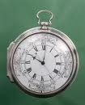


Workshop Rules & Organiztion
الأدوار داخل مجموعات العمل
Roles in The Groups

Slide 7
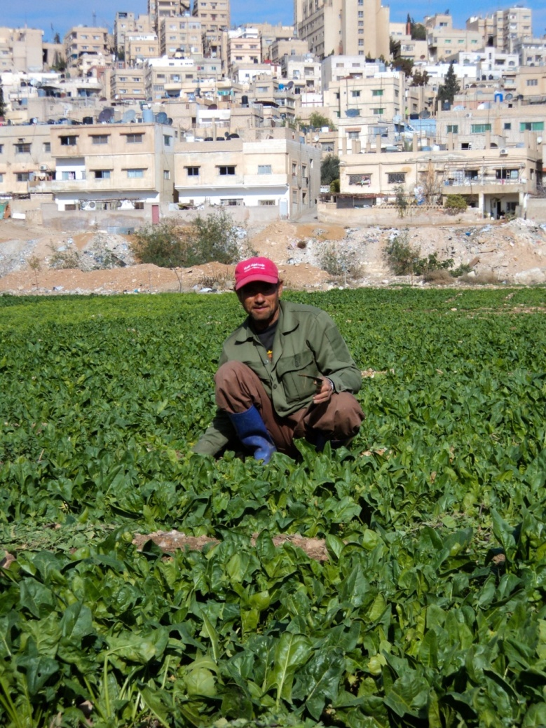
Refresher on the Key Elements of the Proposed Project (RKNW)
  OBJECTIVE
  EXPECTED RESULTS
  TARGET COUNTRIES
  RWKN DEVELOPMENT
  METHODOLOGY
  PROJECT PARTNERSHIP & MANAGEMENT

Slide 8

Generic Concepts, Tools, Procedures and Structures Relevant to Building and Sustaining Knowledge Management Networks
  Different situations require different knowledge management strategies. But …. …
we need a working definition of what KM is. … “Knowledge Management can be thought of as the deliberate design of processes, tools, structures, etc. with the intent to increase, renew, share, or improve the use of knowledge represented in any of the three elements [Structural, Human and Social] of intellectual capital”
Knox Haggie/ CISA, School of Informatics/ University of Edinburgh
John Kingston/ AIAI, School of Informatics/ University of Edinburgh

Slide 9
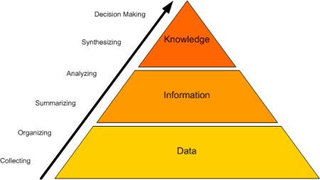

Generic Concepts, Tools, Procedures and Structures Relevant to Building and Sustaining Knowledge Management Networks

Slide 10
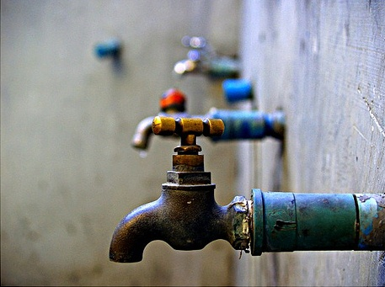
Generic Concepts, Tools, Procedures and Structures Relevant to Building and Sustaining Knowledge Management Networks
Good Governance of a scarce resource

Slide 11
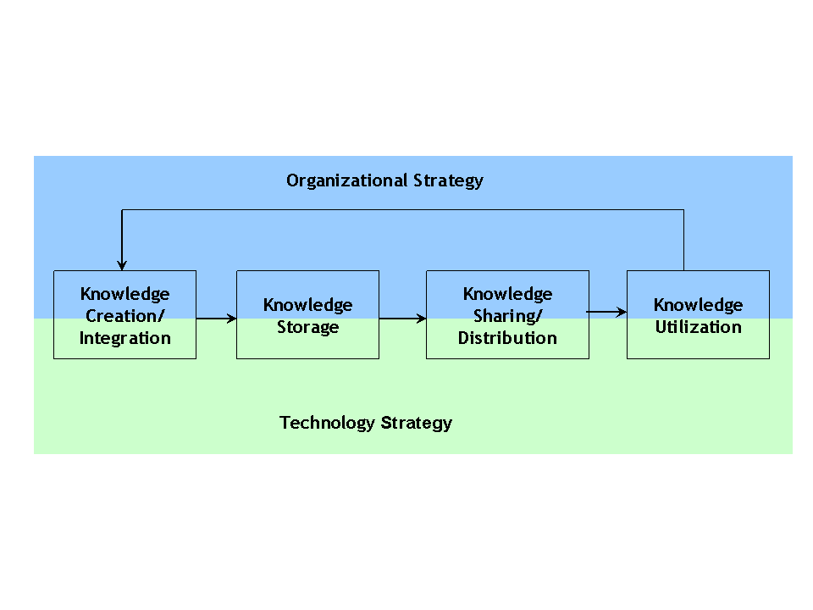
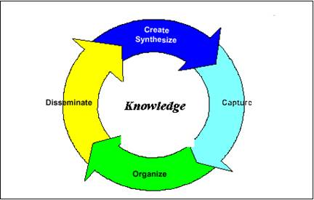
Generic Concepts, Tools, Procedures and Structures Relevant to Building and Sustaining Knowledge Management Networks

Slide 12
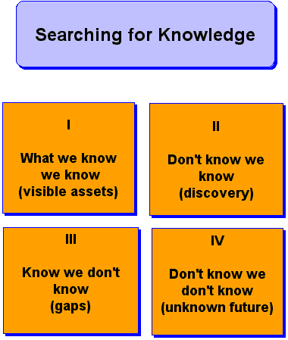
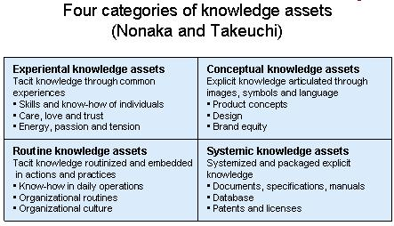
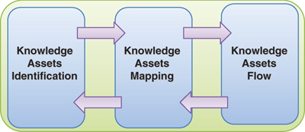
Generic Concepts, Tools, Procedures and Structures Relevant to Building and Sustaining Knowledge Management Networks
  Intellectual Asset Management Strategy …. Corporate & Personal … Explicit & Implicit ….

Slide 13
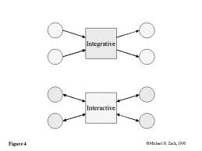

Generic Concepts, Tools, Procedures and Structures Relevant to Building and Sustaining Knowledge Management Networks
  Information & Knowledge Clusters … What are they? Value Added?

Slide 14
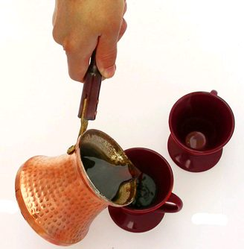

Slide 15
Generic Concepts, Tools, Procedures and Structures Relevant to Building and Sustaining Knowledge Management Networks
  Information & Knowledge Clusters … What are they? Value Added?

Slide 16
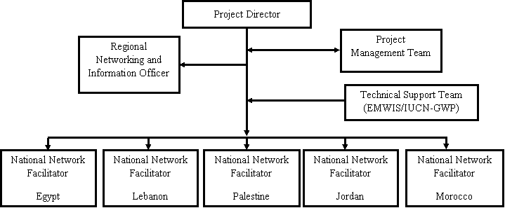
Management Structure

Slide 17
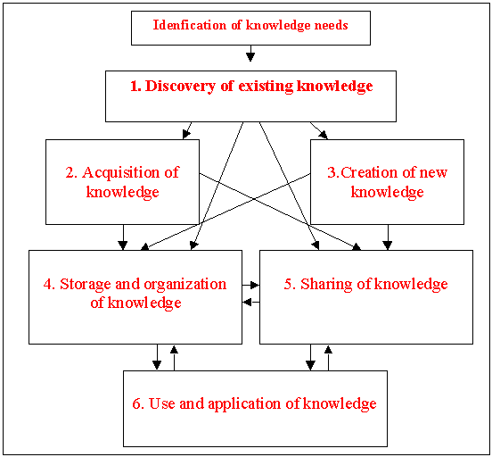
Proposed Conceptual Operational Framework for the Project

Slide 18
Group Work: Brainstorming on the requirements to build and sustain the proposed frameworks

Slide 19
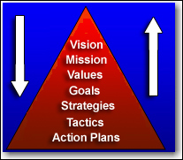

Agreement on Vision & Mission

Slide 20
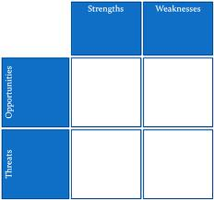
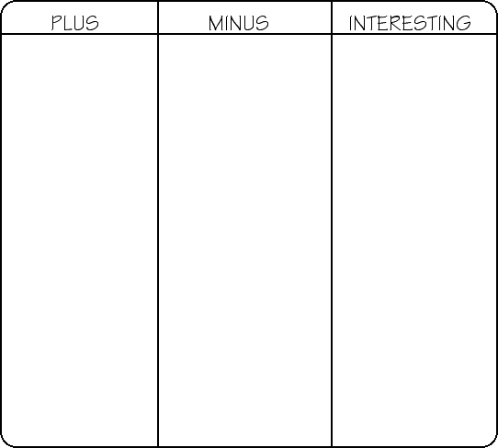
Understanding collective and individual institutional environments as a basis for integration and cooperation (Challenges & Opportunities)

Slide 21
Clustering Ideas Under Key Headlines
Managerial
HuMan Resources
Monitoring & Evaluation
Mandates
Mental
Money/ Material
Knowledge Mgmt.
Mentor
Attitudes & Behaviour
Good Governance
Efficiency & Effectiveness

Slide 22
Generic Concepts, Tools, Procedures and Structures Relevant to Building and Sustaining Knowledge Management Networks
  Knowledge Sharing and Management Matrixes

Slide 23
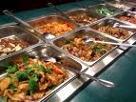

Slide 24
Group Work
Each WG will discuss and present actions needed to fulfill each requirement
الأدوار داخل مجموعات العمل
Roles in The Groups

Slide 26
Group Work
Each WG will discuss and present actions needed to fulfill each requirement
الأدوار داخل مجموعات العمل
Roles in The Groups

Slide 27
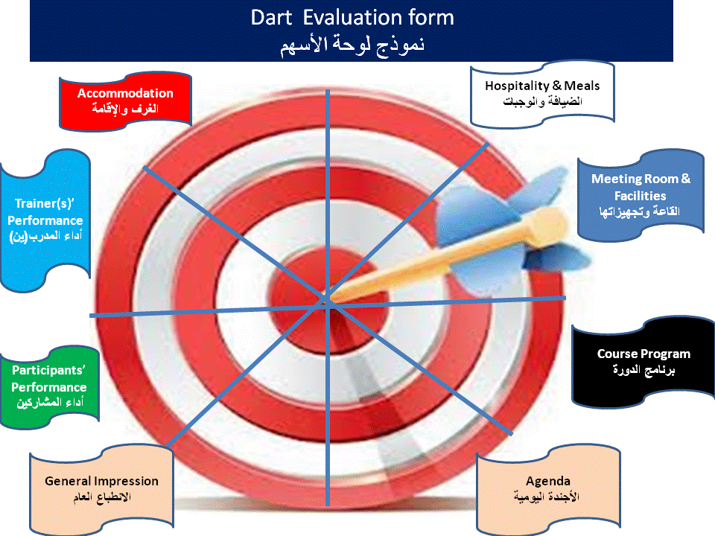
Evaluation of the Day

Slide 28
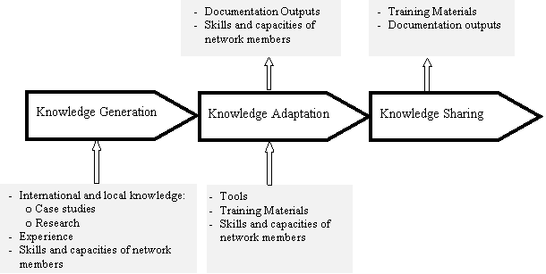
Methodology
The knowledge management cycle will be used to organize the different knowledge management activities and link them to the focus and mandate of the network.

Slide 29
Kick-off Meeting
Rabat, Morocco
9 - 10 June 2013
DAY 2
Regional Knowledge Network on Systemic Approaches to Water Resources Management
2013 – 2015

Slide 30
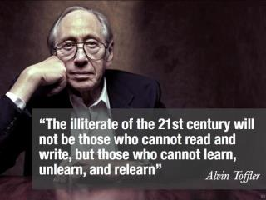

Slide 31
Workshop AGENDA
Time | Day 2 | Who & How?
8:30-8:45 | Recap of Day 1 and Presenting Day 2 Tasks & Programme | Moderator
8:45-9:15 | Presenting Summary of Day 1 Plenary Sessions Outputs | Moderated Plenary Session
9:15-10:15 | Workgroups: Each WG will discuss and present actions needed to fulfill each requirement | Groups' Moderators
10:15-11:30 | Presentations of WGs Outputs: 10 minutes for presentation & 5 minutes for discussions for each WG | WGs Reporters
11:00- | Morning Break Taken in the Group Work
11:30-12:00 | Presenting the Proposed Log-Frame & Road to the Action Plan | Fadi Shraideh/IUCN & Moderator
12:00-13:15 | Building on the Outputs of WGs: Selecting Priority Actions for Year 1 Populating the Action Plan form | Groups' Moderators
13:15-13:30 | Getting Ready for Presentations of WGs Outputs | WGs Reporters & Lara Nassar
13:30-14:15 | Lunch Break
14:15-15:15 | Presentations of WGs Outputs: 10 minutes for presentation & 10 minutes for discussions for each WG | WGs Reporters
15:45-16:15 | Afternoon Break
16:15:17:00 | Finalizing Action Plan Draft | Moderator-Led
17:00-17:15 | Evaluation of the Workshop Closing Remarks & Next Steps | Participants Fadi Shraideh/IUCN & Moderator

Slide 32
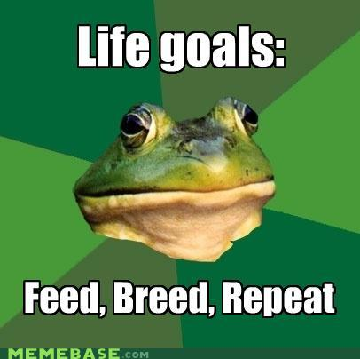



On Vision
Our Vision is guided by the stage of development we achieved so far

Slide 33
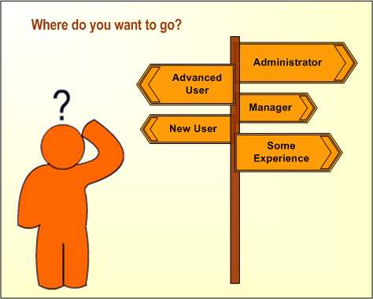

On Vision
If you don’t know where you’re going, then any road ill get you there!
Paraphrase of the Cheshire Cat’s advice to Alice,
in Lewis Carroll’s “Alice in Wonderland”

Slide 34
On Vision
Characteristics of a good vision
VISION
Provides future direction
Expresses a consumer benefit
Is realistic
Is motivating
Must be fully communicated
Consistently followed and measured

Slide 35
Summary of Day 1 Plenary Sessions Outputs: A Proposed Vision
In XXX years, RWKN positioned as a sustainable professional knowledge network on IWRM in the Arabic Countries that brings together and connects the main knowledge providers and the knowledge users attracted by the timely, up to date access to credible applied knowledge and learning
By the year XXX The Marketplace of choice for supply and demand on applied knowledge & learning on IWRM serving the Arab countries
Characteristics of a perfect/efficient market?!
Customer Needs
Transparency
Value for Money (Effort)
Friendly

Slide 36
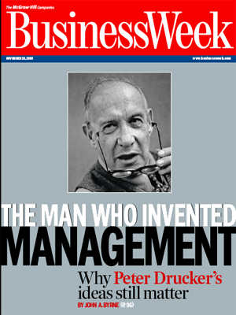
Summary of Day 1 Plenary Sessions Outputs: Proposed Elements for the Mission Statement
Some Conceptual Notes on “Mission Statement”:
Mission: Why you do what you do; the organization's reason for being, its purpose. Says what, in the end, you want to be remembered for.
Criteria for an effective mission statement:
Is clear and easily understood
Defines why we do what we do; why the organization exists
Does not prescribe means
Is sufficiently broad
Provides direction for doing the right things
Addresses our opportunities
Matches our competence
Inspires our commitment
Says what, in the end, we want to be remembered for

Slide 37
Summary of Day 1 Plenary Sessions Outputs: Proposed Elements for the Mission Statement
Promote:
The proper use of knowledge and systematic approaches for better governance and integrated water management)
Best practices in systematic IWRM are standard region wide
Empower Action Takers
Influence Decision & Policy Making (Advocacy)

Slide 38
Clustering Ideas Under Key Headlines
Managerial
HuMan Resources
Monitoring & Evaluation
Mandates
Mental
Money/ Material
Knowledge Mgmt.
Mentor
Attitudes & Behaviour
Good Governance
Efficiency & Effectiveness

Slide 39
Group Exercise: Information Needs & Assets
  Can we think of headlines?
 |  |  | Inst. 2 | Inst. 1
 |  |  |  |  | Theme 1
 |  |  |  |  | Theme 2
Group 1: Management & Operation
Group 2: Communication and Networking
Group 3 Distribution of Tasks and Roles

Slide 40
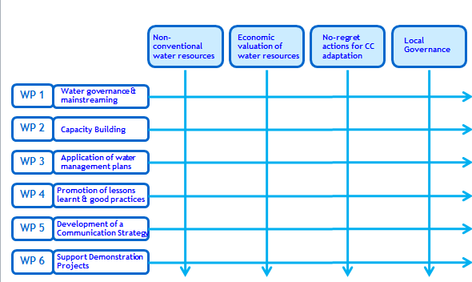
THE SWIM WORK PACKAGES AND PILLARS
Group 1: Management & Operation
Group 2: Communication and Networking
Group 3 Distribution of Tasks and Roles

Slide 41
The Proposed Log-Frame & Road to the Action Plan
LOGICAL FRAMEWORK FOR THE PROJECT
 | Intervention logic | Objectively verifiable indicators of achievement | Sources and means of verification | Assumptions
Overall objective | The use of Systemic Approaches to Integrated Water Resources Management throughout the region among local authorities, other decision-makers, researchers, experts, practitioners and other stakeholders has improved
Specific objective | A Regional Water Knowledge Network (RWKN), existing of linked platforms at different geographical levels, bringing together a range of institutions interested in the creation of new knowledge in systemic approaches for water management is functional
Expected results | 0. The project is adequately managed and administered
 | 1. The Regional Water Knowledge Network (RWKN) has been established
 | 2. Lessons learned of successful demo projects applying systemic approaches to water management are collected and distributed over the Network
 | 3. Knowledge, insights and awareness on systemic approaches to sustainable water resource management has been increased, shared and disseminated
 | 4. Guiding papers on systemic approaches that could be applied to Natural Resources Management have been developed and distributed
 | 5. The capacity of local authorities to use systemic approaches has been strengthened

Slide 42
An Expanded Version of the Traditional Log-Frame
Specific Objectives, Results, Activities | Measurable Indicators | Means of Verification | Achievable Assumptions | Responsibility | Resources | Time
Impact التأثير
Goal الهدف العام
Objective 1 الهدف المؤسسي
Result 1 النتيجة/المخرج
Prog./Proj برامج/مشاريع
Activities أنشطة

Slide 43
SMART Objectives

