Slide 1
Consultative Meeting - OIC Summit on Food, Agriculture, and Water Sector,
1-2 December, 2014 at COMSTECH, Islamabad
Land Use, Food Security, Biotechnology
in OIC Countries
Dr. Münir Öztürk (M.Sc., Ph.D., D.Sc.), Fellow of the Islamic World Academy of Sciences,
Professor (Emer.) of Ecology & Environmental Sciences, Botany Department and Founder Director Centre for Environmental Sudies, Ege University, Bornova- Izmir, Turkey;
Consultant Fellow Faculty of Forestry, Universiti, Putra Malaysia, Selangor- Malysia;
Distinguished Visiting Scientist, ICCBS, Karachi University, Pakistan

Slide 2
Global Trends
1-Increase in world population. 2-Decrease in acreage.
3-Extreme weather conditions. 4-Climate change.
5-Decrease in the fresh water supplies.
6-Increase in Desertification.
7-Decrease of fossile fuels (natural resources).
8-Ageing Society.
9-Change of dietary habits.

Slide 3
Challenges to Land Use & Food Security
by 2050
Population
Increases (to 9.1 billion)
Food Production
Increases (by 50%)
Land area for agriculture
Decreases (0.25 ha/person)
Decreases (Water scarcity in 75% population)
Water
Availability
Crop
Intensification
Increases (to meet the food demand)
Soil & water salinization
Increases
Notes:
ANNEX 10

Slide 4
Economic Losses due to Overuse of Lands
Global agricultural productivity losses
(Estimated for 1 mill. ha of degraded soils).
Irrigated agriculture 11.4 bill. $ / year
Non-irrigated agriculture 1.2 bill. $ / year

Slide 5
Severity of Human-induced Land Degradation.

Slide 6
Land Degradation - Human Agricultural Activities.

Slide 8
Drought- Famine - Migration
These pose: environmental, human, food,
health, livelihood,
social- national-international security challenges,
vulnerabilities & risks.

Slide 9
THEREFORE:
Greatest concern of the OIC countries is the appropriate management of our land resources and how can we feed the next generations in a manner that respects our ﬁnite natural resources.
Additional pressure will be placed on how we can utilize the natural resources required for food production more efﬁciently and how can we employ these in a sustainable manner.
GREATEST need is to start planning now for managing these resources in a sustainable way for the year 2050 and beyond.

Slide 10
During the last 9000 years we have primarily relied on intensive land use for agricultural activities to increase our food production.
Increased incorporation of arable land for food production continues in OIC countries even today.

Slide 11
Projections of increase as well as decrease of arable land for food production by FAO for 2012 show:
-there will be an increase in the
land for producing food in
OIC countries due to growing
economies as the variety of foods
consumed will increase.

Slide 12
FOOD SECURITY
Food Security (WHO,1996) means-when all people at all times have access to sufﬁcient, safe, nutritious food to maintain a healthy and active life.
Food Security (USDA, 2013) means the households that have consistent, dependable access to enough food for active, healthy living.
How to Feed the World in 2050 (FAO Report):
THREE drivers affecting the food security are;
demographic outburst, increase in urbanization, and increase in income.

Slide 13
BUT: Overuse of our lands not a sustainable way as land is a ﬁnite resource.
A must that OIC countries should increase food production on the degraded lands lying waste.

Slide 14
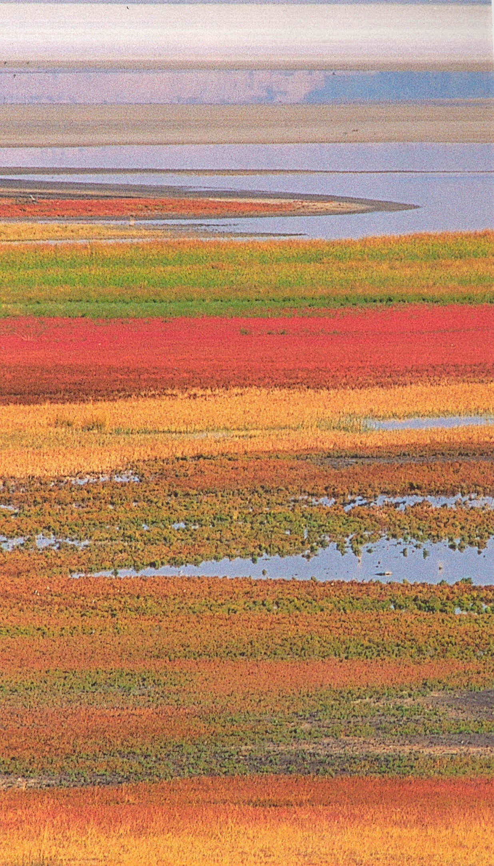
Beneath many of deserts are reserves of saline
waters.
Major occurrences of saline waters in OIC Countries:
Arabian desert of the Middle East,
Sahara Desert in North Africa,
Kalahari Desert in Southern Africa.

Slide 15
“HALOPHYTES” -A Solution to the Problem!
A great potential for consumption
as well as amelioration of
degraded lands.
Natural habitats of this plant diversity
1-coasts,
2-coastal lagoons,
3-salt flats,
4-sea cliffs,
5-estuaries,
6-saline inland lake shores.

Slide 16
Areas with high ground water salinity can be used for halophytic forage crop production.
A library of germplasm for the discovery of new uses & development of new crops for future use.
There are more than 1500 species of vascular salt-tolerant plants distributed in over 500 genera with a great economic potential reported.

Slide 17
HALOPHYTES:
→ can contribute to food security.
→will help to cover the basic needs of people in OIC countries.
→ can help to decelerate (reverse?) the extension of deserts and reclamate degraded lands.
→ reduce the greenhouse effect.

Slide 18
Biotechnology
Revolutionizing all fields of our life.
Globally recognized as:
-a rapidly emerging complex,
-far reaching new technology,
-an interdisciplinary branch of science,
encompassing a wide range of subjects.

Slide 19
6
Biotechnology Sector
(After Nermin Gözükırmızı)
Health and Gene Technology
Environmental Biotechnology
Agricultural Biotechnology
Industrial Biotechnology

Slide 20
11
Agricultural Biotechnology
Pharmaceutical products
Experimental models
‘Knock-out mouse’
Food
Biofarming
Amelioration
Value added foods
Transgenic Animals
Transgenic Plants
After
Nermin Gözükırmızı

Slide 21
Little attention paid towards biotech due to lack of funds and expertise.
Recent discoveries & technical innovations in BT depict:
Convergence of advances in:
genomics,
proteomics,
bioinformatics and
information technologies
are driving the emergence of a new bio-economy.
Use of this technology is providing remarkable success in increasing crop productivity, improving crop quality for overcoming food shortage.

Slide 22
BUT IN OIC COUNTRIES;
No investors specialized in biotechnology & private funding is still rare.
Level of awareness about possible potential returns from the industry among investors is low.
Few links exist between academia and industry.

Slide 23
Future impacts of BT in crop production will be in the areas of:
1.Developing new hybrid crops based on genetic male-sterility.
2.Exploiting transgenic apomixes to fix hybrid vigour in inbred crops.
3.Increasing resistance to insect pests, diseases, and abiotic stress factors.

Slide 24
4.Improving effectiveness of bio-control agents.
5.Enhancing nutritional value of crops & post-harvest quality.
6.Increasing efficiency of soil phosphorus and essential micronutrient uptake and their translocation in plants.

Slide 25
7.Increasing the nitrogen fixation capacity of legumes.
8.Signalling & regulation of Nitrogen metabolism, engineering plants with other gene systems in this direction.
9.Understanding the nature of gene action and metabolic pathways.
10.Increasing photosynthetic activity, sugar and
starch production (Harvesting the SUN).

Slide 26
11. Genomic Approach for Crop Improvement.
12. Proteomics & Crop Improvement.
13. Nanobiotechnology & Crop Improvement.
OIC countries should organize their future research in this direction to avoid dependancy on others.

Slide 27
1-All OIC countries possess huge areas of
unused marginal land.
2-Reasons are:
-lack of technical staff,
-fragmented lands,
-lack of coordination, policies and
legislation at the government level.
3-Decrease in food supplies & high prices will prove
detrimental for these countries, making them
critically vulnerable to any disruption and may
produce devastating effects on their economies.

Slide 28
4-Money spent on the imports of food stuffs will be higher than their debt relief and more than that spent on overcoming health and poverty problems, leading to a serious set back in the poverty reduction and economic development efforts.

Slide 29
5-Water scarcity is and will be a major constraint in agricultural production, unless alternative crops like halophytes are used.
6-An increase in the degraded lands will affect food security for the poor negatively, since food prices are likely going to rise.

Slide 30
7-Sustainable land strategies must be
created that are compatible with the
climatic, environmental and
socio-economic conditions prevailing
in each country.
8-Links between water, energy and
poverty should beconsidered together
taking into account not onlytechnical
and market issues but also the social
and institutional aspects.

Slide 31
9-Strong partnerships between
farmer- public- private entities,
supportive government policies,
significant start- up investment,
and
a strong research as well as
development orientation to the
joint program is required.

Slide 32
10-Active participation of farmers through their producer organizations is the best guarantee that the use of degraded lands will contribute to the food security
11-Need for political and legal stability at all
levels, together with
an involvement of all stakeholders,
legislative framework,
feedstock selection,
availability, price, marketing strategy,
quality control, and plant site selection.

Slide 33
12-The Universities, Government bodies and Private Sector in the OIC countries should join hands in the successful implimentation of programmes for growing crops on degraded lands and attempts made for capacity building as well as transfer of technology among the countries.
13-Training courses and workshops should be organised under the umbrella of “COMSTECH” on regional basis to update and exchange information as well as know-how among the OIC countries.

Slide 34
OIC countries: Many Research Organisations Existing
1-International Centre for Biosaline Agricultural, Dubai, UAE
(ICBA).
2-UNESCO Chair Halophyte Utilization-Karachi University,
Pakistan.
3-Agricultural Faculties and Research Institutes in Egypt ,
Morrocco, Pakistan, Saudi Arabia, Tunisia, Turkey and Uzbekistan.
4-International Centres for Arid Lands & Desertification-
Konya (Turkey), Samarqand (Uzbekistan) and Egypt.
6-Bitechnology Research Centres in Pakistan, Turkey & Tunisia.
Many young talented workers present.
COORDINATION ? How Much?

Slide 35
14-Research and development are paramount for future, based on short-term improvement of existing feedstock and technologies.
15-IDB can support major collaborative “Pilot Projects” on socio-economic and environmental impacts of growing crop on degraded lands.

Slide 36
37
Another aspect in this connection is:
Food Safety Testing Market (Pathogens, GMO’s, Toxins, Pesticides).
Will be 14,030.2 Million $ By 2018 –
New Report by Markets and Markets (March, 2014)
Global food safety testing market:
2012 - 09,262.3 million $.
2018 -14,030.2 million $.

Slide 37
NEED FOR CONVERGENCE:
We the OIC citizens should change into a community to serve the caloric needs of inhabitants.
We must change into a community to grow the food that we need for population.
We must become a community so as to insure that our future generations have food to eat in this era and beyond.

Slide 38
A widespread education for the public & special - technical education for the farmers is needed for the protection of our soils.

Slide 39
1-Ozturk,M., Waisel,Y.,Khan, M.A., Gork,G. (Eds.) 2006. Biosaline Agriculture and Salinity Tolerance in Plants. Birkhauser Verlag (Springer Science), Basel.
2-Chedlly, A., Ozturk,M., Ashraf,M.,Grignon,C., (Eds.) 2008. Biosaline Agriculture and High Salinity Tolerance. Birkhauser Verlag (Springer Science), Basel.
3-Ashraf, M.; Ozturk, M.; Athar, H.R. (Eds.) 2009. Salinity and Water Stress: Improving Crop
Efficiency, Series: Tasks for Vegetation Science , Vol. 44 , Springer Verlag.
4-Ozturk,M. 2010. Sabkha Ecosystems III, Africa & Southern Europe.Tasks for Vegetation
Science, Springer Verlag.
5-Ozturk,M.Mermut,A.,Celik,A. 2010. Land Degradation, Urbanisation, Land Use & Environment, NAM S. & T. (Delhi-India).
6-Ashraf, M., Ozturk, M., Ahmad,M.S.A.,Aksoy,A. (Eds.) 2012. Crop Production for Agricultural Improvement. Productivity:Springer Verlag.
7-Hakeem,K.R., Parvaiz, A.,Ozturk,M. (Eds.) 2013. Crop Improvement-New Approaches and
Modern Techniques. Springer Verlag, XXVII.
8-Khan, M.Ajmal, Boer, B., Ozturk,M., Al Abdessalaam, T., Clüsener-Godt, M., Gul,B. (Eds.) 2014. Sabkha Ecosystems: Volume IV: Cash Crop Halophyte and Biodiversity Conservation Tasks for Vegetation Science: 47, Springer Verlag.
9-Hakeem,K.R., Sabir,M., Ozturk,M., Mermut,A. 2014. Soil Remediation and Plants-Prospects and Challenges. Elsevier.

Slide 40
1-Ozturk, M.A., 1995. Recovery and rehabilitation of mediterranean type ecosystem- A case study from Turkish maquis. In: Evaluating and Monitoring the Health of Large-Scale Ecosystems, NATO-ARW(Eds.D.Rapport,C.L. Gaudet, P.Calow), Springer- Verlag.
2-Ozturk, M.,1999. Urban Ecology and Land Degradation. In: Perspectives in Ecology (Editor:Almo Farina). Backhuys Publishers, Leiden, NL.
3-Ozturk, M., Alyanak,I.,Uysal,I., Guvensen,A., Sakcali, S.2004. Multipurpose Plant Systems for Renovation of Wastewaters. Salinity Mitigation for Efficient Water Resources Management Proc.11, (Eds. M.Latif & S. Mahmood) CEWRE Publ.194, Lahore-Pakistan.
4-Ozturk,M., Gucel,S., Sakcali,S., Gork,C., Yarci,C., Gork,G.2008. An overview of plant diversity and land degradation interactions in the eastern Mediterranean. Chapter 15, In: Natural Environment and Culture in the Medit. Region (Eds.Efe et al.),Cambridge Scholars Publ.,UK.
5-Hakeem,K.R.,Ozturk,M., Memon,A.R.2012. Biotechnology as an Aid for Crop Improvement to Overcome Food Shortage. In. Crop Production for Agricultural Improvement (eds. Ashraf et al.) Springer Verlag.
6-Ozturk,M., Gucel,S.,Sakcali, S.,Baslar, S. 2013. Nitrate and Edible Plants in the Mediterranean Region of Turkey: An Overview.In: Nitrate in Leafy Vegetables-Toxicity and Safety Measures (eds. Umar,S. et al.), pp: 17-51. I.K. Intern. Publ.House Pvt. Ltd.New Delhi-Bangalore (India).
7-Ozturk,M., Altay,V., Gucel,S. 2014. Halophyte Plant Diversity in the East Mediterranean-Their Medicinal and other Economical Values. In: Sabkha Ecosystems Vol IV Cash Crop Halophytes Biodiversity & Conservation (Eds. Khan,A,M., Boer, B., Ozturk,M., Al-Abdessalaam, T. Z., Clüsener-Godt) Tasks for Vegetation Science Series, Springer Verlag.

Slide 41
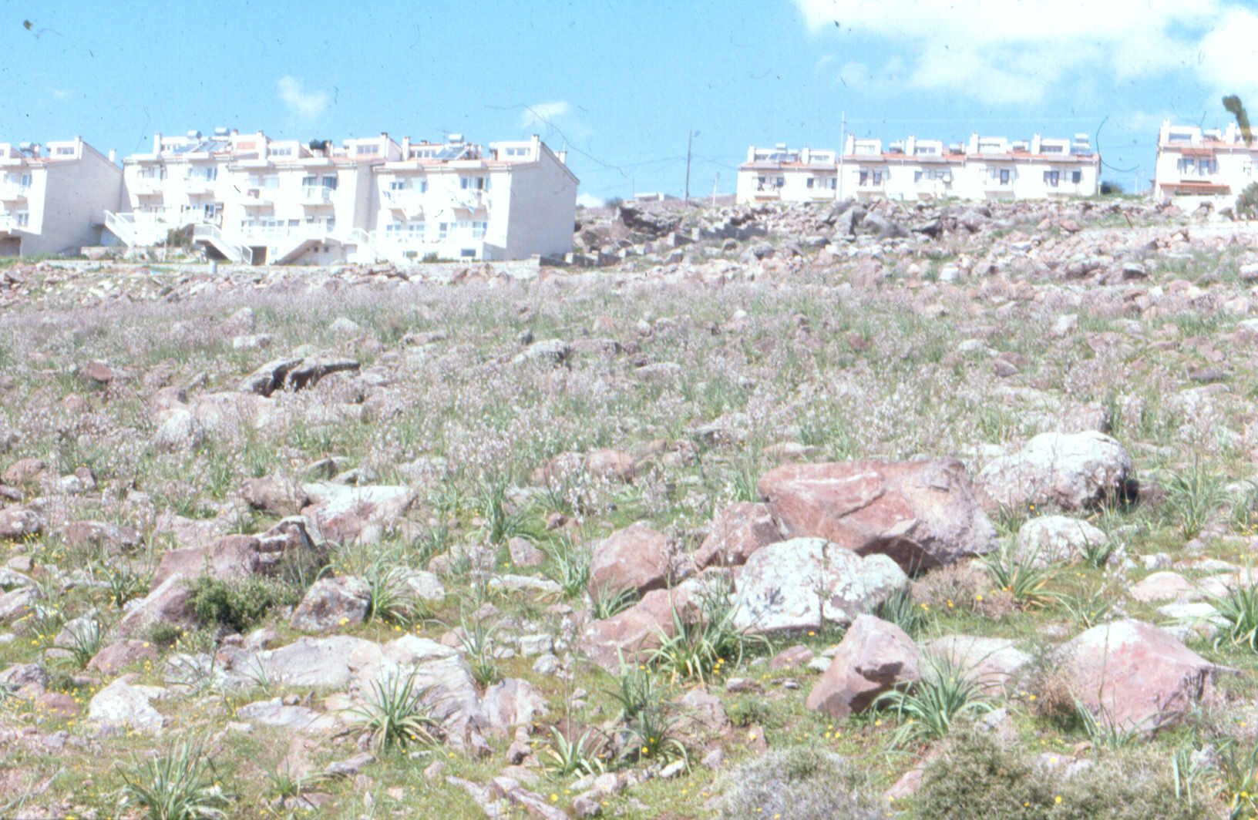
THANKS FOR YOUR
KIND ATTENTION

