Slide 1
SUSTAINABLE DEVELOPMENT
THE CHALLENGE OF WATER AND SOIL
Par:
Mr. Cherif KHAMMAR

Slide 2
SUSTAINABLE DEVELOPMENT ANSWER TO NEEDS OF THE PRESENT WITHOUT COMPROMISE THOSE OF FUTURE GENERATIONS
THROUGH:
THE ECONOMY OF NON RENEWABLE RESOURCES
THE ECONOMY OF TERRITORIES AND SPACES.
THE RESPECT OF ENVIRONMENT.
BETTER MANAGEMENT OF FRAGILE MIDDLES
THE PROMOTION OF SUSTAINABLE JOBS.
YOUTH TRAINING.
THE REDUCTION OF POVERTY AND EXCLUSION.
THE ENCOURAGEMENT OF ECO-CITIZENSHIP

Slide 3
WATER + MAINLAND =
AGRICULTURAL DEVELOPMENT
FOOD SATISFACTION
FIXING POPULATION AND CONTROL AGAINST RURAL EXODUS
AMENAGMENT OF TERRITORIES AND DEVELOPMENT OF NEW SPACES FOR ACTIVITY AND LIFE.
REDUCTION OF POVERTY AND UNEMPLOYMENT

Slide 4
WATER IN MEMORY PEOPLE
Water, symbol of life, fertility and fecundity,
The water present in all religions, for purifying virtues:
-water Ablutions in Islam (Zem Zem water) -water Holy baptism in Christianity -water Of the Ganges, the sacred river of the Hindus
Water thermal treatment
Water of Youth,
Water around which are created and developed civilizations and great cities (Nile, Euphrates, Tigris)

Slide 5
WATER AROUND THE WORLD
Resources: - Salt water = 97,5 %
1400 MILLIONS KM3
- Sweet water = 2,5 %
35 MILLIONS KM3
Sweet water:
Ice / Snow = 2/3
24 MILLIONS KM3
Underground water = 1/3
11 MILLIONS KM3
Rivers, reservoirs, lakes = 0,3 %
100 Thousand KM3

Slide 6
the volume of water in the world, and the atmosphere does not change with time; only the geographical distribution and availability are changing under the influence of climate changes

Slide 7
RESOURCES / POPULATIONS
ASIA : 61% of world population
36% of used water resources
EUROPE: 12% of world population
8% of used water resources
SOUTH AMERICA: 6% of world population
26% of used water resources
AFRICA: 16% of world population
10% of used water resources

Slide 8
ALL STATISTICS SHOW THAT IN 2050 ONLY 40 % OF THE WORLD POPULATION WILL CERTAINLY MISS WATER DUE TO
INEQUALITIES
World consumption X 3.2 since 1950
World population X 2.7 since 1950
Sampling of groundwater-world doubled between 1960 and 2010 .

Slide 9
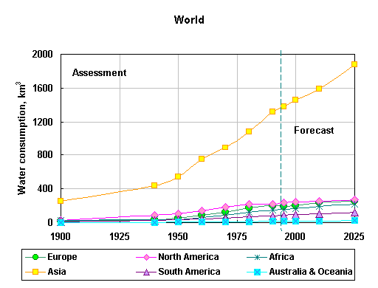

Slide 10
MEAN CONSOMMATIONS
AGRICULTURE :70% (90 % in India , Mexico)
15000 L = 1 KG meat or hamburger
6000 L = 1 Mouton and 5000L= 1KG rice
1000 L = 1 KG citrus fruit / vegetables / dry tuber
1000 L = 1 KG bread- 1 KG coffee
INDUSTRY 20% (40% in developed countries )
120000 L = 1 Vehicle
400-1000 L = 1KG rayon (fabric)
500 L = 1 KG paper
35 L = 1 KG cement
DOMESTIC : 10% of which 80% in developed countries .
400 to 500 L / hab / Day = USA
200 to 300 L / hab / Day = EUROPE
170 L / hab / Day = ALGERIA
30 L / hab / Day = AFRICA

Slide 11
THE PARADOXE OF WATER
On the one hand
the volume of water unsuitable for consumption increases at the expense of volume of fresh water that we consume.
On the other hand
the geographical distribution of Water moves randomly unrelated to the needs of populations ; so, often the consequences are:
RARITY = DISASTER
EXCESS = DISASTER

Slide 12
THE CONSEQUENCES
1.5 billion people : no access to water potable
2.5 billion people : difficult access
30 000 people are killed every day by water
30 million people a year , are contaminated by the penury and no healthy, the first cause of mortality for the quarter of humanity
40% of the 700 millions Africans without access to drinking water

Slide 13
FIRST CONCLUSION WE CAN TAKE IS THAT THE CRISIS WORLD WATER IS NOT ONLY CRISIS SHORTAGE BUT ALSO:
A PERIOD OF NATURAL EVOLUTION OF THE ALLOCATION OF RESOURCES
AGGRAVATED BY CRISIS MANAGEMENT RESOURCES .

Slide 14
WHAT IS IT NOW ON AGRICULTURAL PLAN ?
BECAUSE
70%WATER IS CONSUMED BY AGRICULTURE

Slide 15
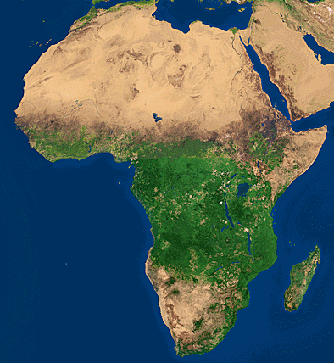
AFRICA IS THE REGION MOST THREATENED BY THIS DEVELOPMENT

Slide 16
WATER IS LITTLE MOBILIZED AND OFTEN DEVASTATING WHEN IS ABUNDANT, AND OFTEN DEGRADED WHEN IT IS RARE.
70 MILLION ACRES ARE SERIOUSLY DEVASTATED BY DESERTIFICATION

Slide 17
THE WEIGHT OF AGRICULTURE
35% OF PNB
40% OF EXPORTATIONS
70% OF HIS HAND LUMBER
70% OF THE RURAL POPULATION

Slide 18
SPECTRUM FOOD INSECURITY
This is the only region where the level of supply of food per person has fallen over the past five years.
200 MILLION PEOPLE
SUFFER FROM MALNUTRITION

Slide 19
GEOPOLITICAL DIMENSION OF WATER
WATER IS A MAJOR VECTOR OF THE ORGANIZATION OF SPACE BECAUSE IT CONDITIONED WITH ITS ABSENCE OR ITS PRESENCE NOT ONLY THE EXISTENCE OF ANY TERRITORY BUT ALSO :
-ITS SIZE ,
-ITS HUMAN OCCUPATION ,
-ITS ECONOMY ,
-ITS AGRICULTURE ,
-AND OFTEN ITS DESIRE..

Slide 20
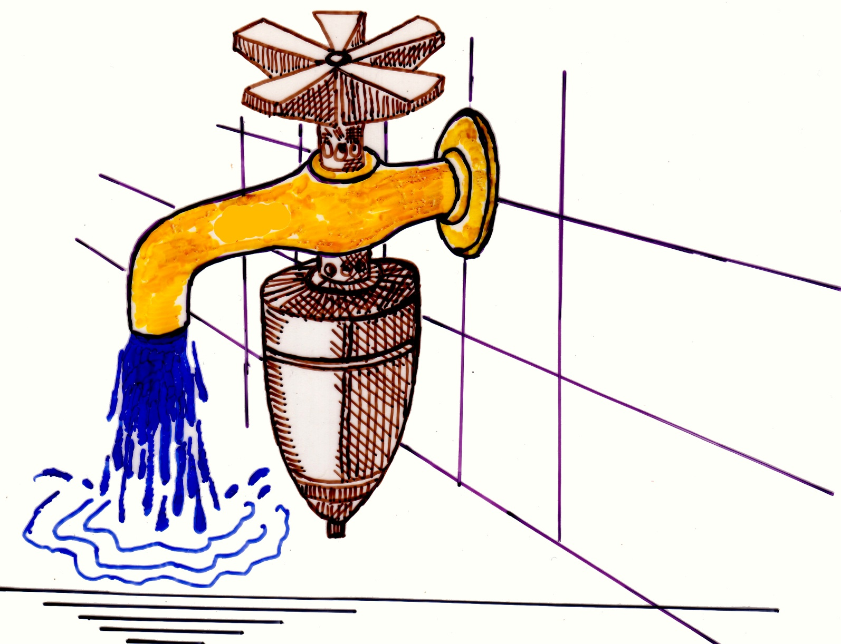
WATER MAY BE A SOURCE OF CONFLICT AS WELL AT LOCAL AND AT WIDE WORLD

Slide 21
 | ENERGY | WATER | SOIL | ?
ALGERIE | + + | - | + + | ?
LIBYE | + + | - - | + | -
NIGERIA | + + + | + + | + + + | -
SOUDAN | + | + + + | + + + | -
ETHIOPIE | - - - | + + | + | -
CONGO | - - | + + | + + | -
TCHAD | - | - - - | + | -
NIGER | - - - | - - | + | -
MALI | - - - | - - | + | -

Slide 22
TOMORROW : WATER WAR ???
We live in a world where war is ever more economic and based on:
the need for a resource,
need to possess or sell ,
the problem of sharing.
This resource is not religion or territory as was to conquer in time. It is a resource , product, necessary for the development and life today.
IT WAS THE OIL AND GAS YESTERDAY TODAY,
TOMORROW IT WILL BE WATER AND FOOD

Slide 23
Thus, water is becoming now a real technological challenge , financial and political , as was then and still is energy worldwide
If the 20th century was the century of Energy and Industry , the 21st century will certainly be one of
WATER AND FOOD

Slide 24
STRATEGIC PLAN
2016-2025
PROPOSITIONS
OF
RECOMMANDATIONS

Slide 25
WATER - ENERGY -ALIMENTATION
DRIVER REGIONAL PROGRAMME ON ASSESSMENT OF INTERACTION ENERGY WATER -ALIMENTATION- ECOSYSTEM (In collaboration with African Energy Commission , United Nations Economic Commission , Global Water Partnership (GWP ) , SASS)

Slide 26
DEVELOP A COMMON APPROACH OF RESOURCES MANAGMENT TO STRENGTHEN FOOD SECURITY AND WATER ENERGY

Slide 27
SEARCH SYNERGY OF EXISTING PROGRAMS
DEVELOPING THE PARTNERSHIP BETWEEN THE CONCERNED INSTITUTIONS IN LOCAL , REGIONAL AND INTERCONTINENTAL LEVEL

Slide 28
HYDRO-AGRICULTURAL DEVELOPMENT
PURSUIE AND CONSOLIDATE THE EVALUATION AND THE MOBILISATION CONVENTIONAL AND UNCONVENTIONAL WATER RESOURCES

Slide 29
REHABILITATION AND EXTENSION SYSTEMS SUPPLY DRINKING WATER, SANITATION AND FLOOD PROTECTION
TO GENERALIZE
ACCESS TO WATER , IMPROVE THE LIVING ENVIRONMENT AND PROTECT THE ENVIRONMENT AND ESPECIALLY WATER ENVIRONMENT

Slide 30
REHABILITATION AND EXTENSION SYSTEMS IRRIGATION
PRIORITIZING PROJECTS TARGETING THE DEVELOPMENT OF AGRICULTURAL AND RURAL WATER ( large areas - PMH- Reuse of treated wastewater for Irrigation –Reenforcement of domestic water in rural areas and sparse population)

Slide 31
IMPLEMENTING A MANAGEMENT OF WATER INFRASTRUCTURES PATRIMONY
CONSOLIDATE THE GOVERNANCE OF WATER THROUGH INSTITUTIONAL SUPPORT MEASURES

Slide 32
DEVELOPMENT AND UPDATING OF NATIONAL PROGRAMS WATER :( basis of overall economic assessment ,Investment Planning , permissions - programs and timelines for the planning period )
DATABASE FOR COOPERATIVE MANAGEMENT OF WATER RESOURCES: ( base for policy formulation and joint management strategy)

Slide 33
INSTITUTIONAL SUPPORT MEASURES
PUBLIC DOMAIN HYDRAULIC: -Strengthen Water police (sample?) -Strengthen The authorization device and concession of use of water resources

Slide 34
PROTECTION OF PATRIMONY :
Specific dispositions in times of shortage -Security Dams (legal texts) -Organization And management of water services (SPA creation and revision of the pricing for better rationalization of the use of water)

Slide 35
FOR THE ADAPTATION OF THE WATER SECTOR ORGANIZATION : -Integrate Planning function (central, regional and local) -Develop Training -Promote Research and Development (Water Science and Technology)

Slide 36
THANK YOU FOR YOUR ATTENTION

